Slide 1

ANALYSIS OF MINI PROJECT-II

Slide 2
TOPIC OF FULL ANALYSIS
DATA ANALYTICS WITH MACHINE LEARNING
PROJECT ON COMPUTER VISION: FACE DETECTION AND RECOGNITION

Slide 3
Basics of machine learning
Machine learning is the science of getting computers to learn and act like humans do,and improve their learning over time in autonomous fashion,by feeding them data and information in the form of observation and real world interactions.
It is branch of airtificial intelligence based on the idea that systems can learn from data,identify patterns and make decisions with minimal human intervention.
Machine learning at its most basic is the practice of using algorithms to parse data, learn from it, and then make a determination or prediction about something in the world.

Slide 4
Steps involved in machine learning
Data collection
Data split
Training the system
Testing the model
Model storage and reuse

Slide 5
Machine learning methods
1) Supervised learning/predictive models
In basics, learning from the known label data to create a model then predicting target class for the given input.
for example : Machine learning algorithms that make predictions on given set of samples.Supervised ml algorithms searches for patterns within the labels assigned to data points.
1 2 3 4 10
1 4 9 16 ?
Now we discuss about supervised ml in more precise way
supervised ml is where we have input variables(x) and output variable(y) and we use an algorithms to learn the mapping function from the input to the output.

Slide 6
The goal is to approximate the mapping function so well that when we have new input data (x) that we can predict the output variables (y) for that data.
Supervised machine examples:
Cortana or any speech automated system in your mobile phone trains your voice and then starts working based on this training.
Weather apps sometimes.
Based on past information about spams,filtering out a new incoming emails into inbox or junk folder(spam).
Supervised learning includes two categories of algorithms:
Classification: A classification problem is when the output variable is category,such as “red” or “blue” and “no disease”.
Regression: A regression problem is when the output variable is a real value, such as “dollars” or “weights”.

Slide 7
2)Unsupervised learning/Descriptive models
In basics unsupervised learning is the learning from the unlabelled data to differentiating the given input data.
There are no labels associated with data points.
These ml algorithms organize the data into a group of clusters to describe its structure and make complex data to look simple and organized for analysis.
ALGORITHM USED IN UNSUPERVISED ML
Clustering:
when a set of inputs is to be divided into groups. The goal in unsupervised learning is generally to cluster the data into characteristically different groups. Unsupervised machine learning is more challenging than supervised learning due to the absence of labels.

Slide 8
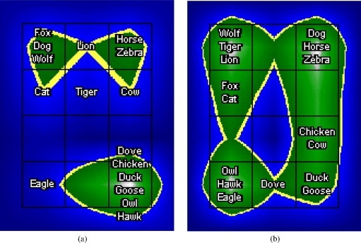
CLUSTERING

Slide 9
Same data can be clustered into different groups depending upon the way clustering is done. If you look at the above figure, 16 animals which were represented using 13 boolean features (appearance and activity based) can be clustered into two ways depending upon whether appearance based features were given more weights or activity based features.
The first partitioning, clusters them into mammals and birds while the other clusters them into predators and preys. Both are equally meaningful and therefore it is up to the scientist to choose his representation to obtain a desired clustering, which obviously is a challenging task.
Unsupervised ml applications
Anomaly/fraud detection in banking sector.
Image segmentation
Gene clustering for grouping gene with similar expression levels etc…

Slide 10
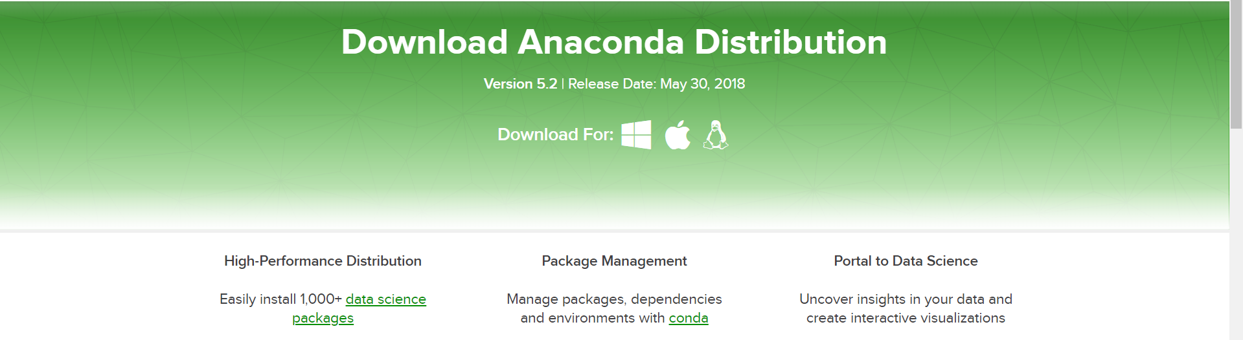
Installation of anaconda and introduction of python package
Anaconda distribution
The most popular python distribution for data science .
Download anaconda distribution: https://www.anaconda.com/download/

Slide 11
Useful commands for conda
COMMAND | DESCRIPTION
Conda info | Verify conda is installed,check version number
Conda update conda | Update conda to the current version
Conda install PACKAGENAME | Install a package included in anaconda
Conda update PACKAGENAME | Update any installed program
Conda create –name py35 python=3.5 | Create a new environment named py35,install python 3.5
Conda env list | Get a list of all my environments,active environment is shown with
Conda list | List of all packages and version installed in active environment

Slide 12
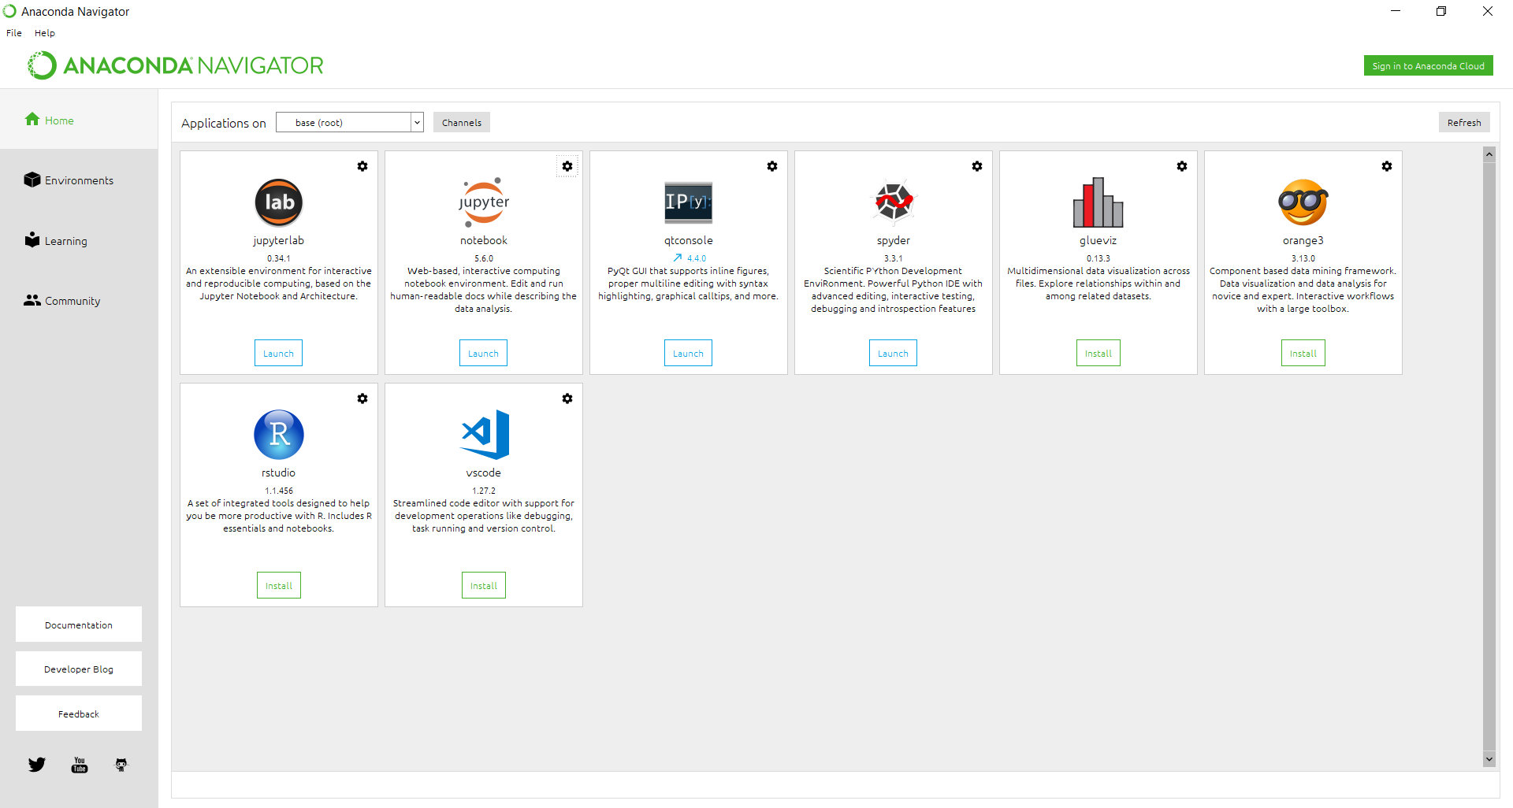
After installation of anaconda distribution

Slide 13
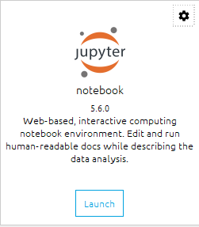
Introduction of jupyter
Jupyter Notebook is a web application that allows you to create and share documents that contain:
Live code(e.g python code)
Visualizations
Explanatory text
Jupyter notebook is great for the following use cases:
Learn and try out python
Data processing/transformation
Numeric simulation
Statistical modelling
Machine learning

Slide 14
Packages of python and modules used in data analysis
Introduction of numpy
Command: conda install – c anaconda numpy
NumPy is the fundamental package for scientific computing with python.It provides a high performance multidimensional array object, and tools for working with these arrays.
Pandas :Powerfull python data analysis
Pandas builds on packages like numpy and matplotlib to give you a single,convenient,place to do most of your data analysis and visualization work.If you are working on data science, you must know pandas python module.
Pandas datatypes:
Series,DataFrame,Panel,Panel4D

Slide 15
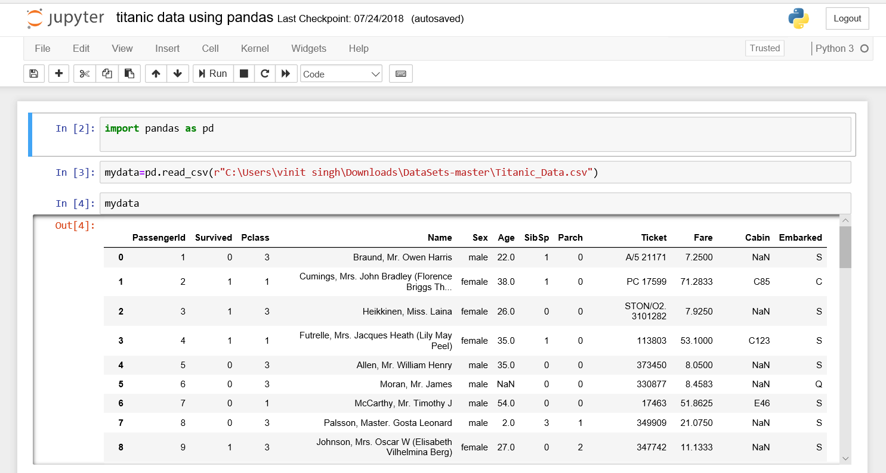
Working with Titanic DataSet
This data has information on passengers from the titanic disaster and is focussed on the problem of using the various pieces of information to create a good predictor of if someone survived the sinking of the ship.

Slide 16
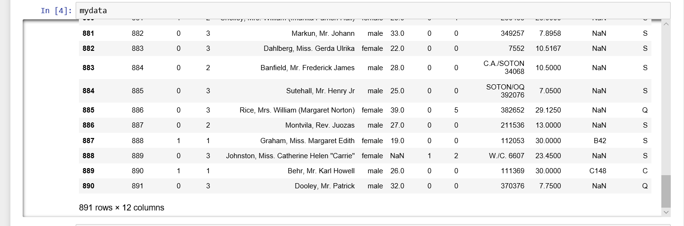

Slide 17
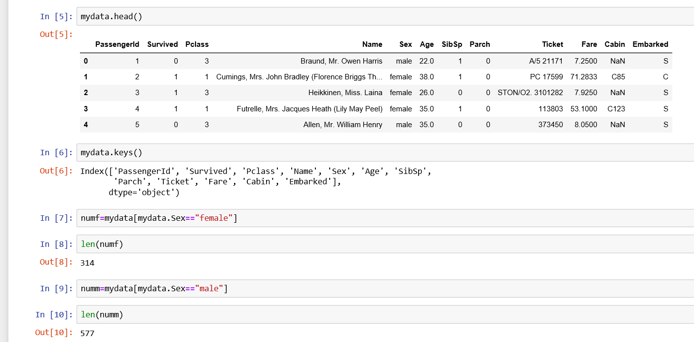

Slide 18
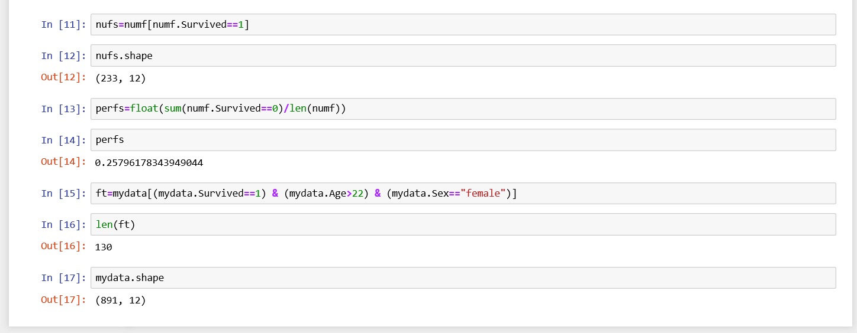

Slide 19
Whole program of Titanic DataSet
Import pandas as pd
Mydata=pd.read_csv(r”Titanic_Data.csv”)
Mydata
Mydata.head()
Mydata.shape
#Extracting only male Data
Maledata=mydata[mydata.sex==‘male’]
#Extracting only female data
Female=mydata[mydata.sex==‘female’]
#men’s survival was different from the women’s
#calculating men and female survival
Men_survived=float(sum(maledata.survived)/len(maledata)
Men_survived
female_survived=float(sum(female.survived)/len(female)
female_survived

Slide 20
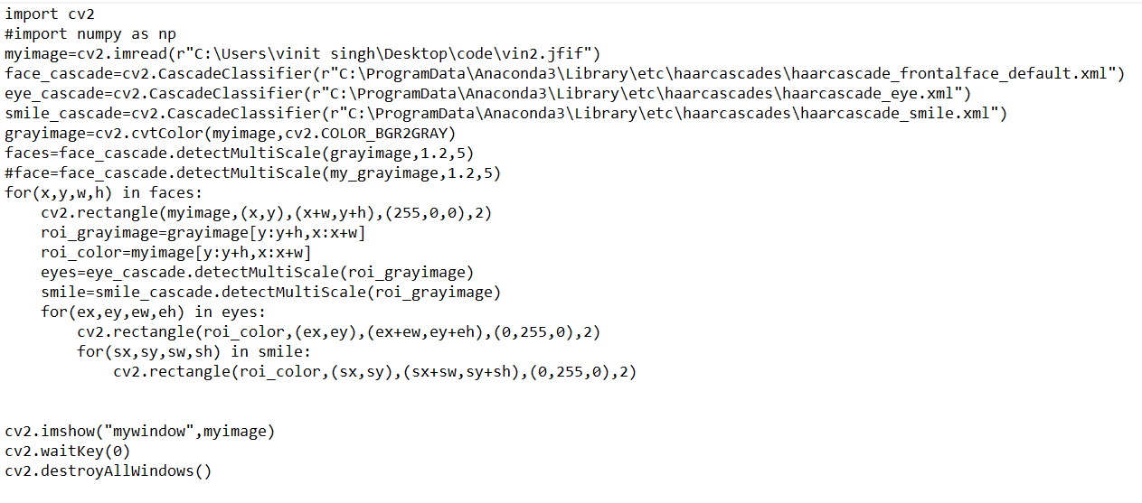
My project: face detection and recognition
for face detection,smile detection and eyes detection following program is used:

Slide 21
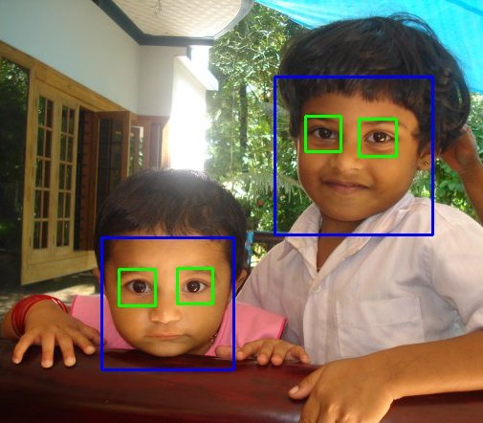

Slide 22
For face recognition
To make a face recognition program, first we need to train the recognizer with dataset of previously captured faces along with its ID, for example we have two person then first person will have ID 1 and 2nd person will have ID 2, so that all the images of person one in the dataset will have ID 1 and all the images of the 2nd person in the dataset will have ID 2, then we will use those dataset images to train the recognizer to predict the 1 of an newly presented face from the live video frame
So lets break the program into 3 major part:
Dataset Creator
Trainer
Detector

Slide 23
Dataset creator
we will need to do the following first:
cv2 library (opencv library)
create a video capture object
cascadeClassifier object

Slide 24
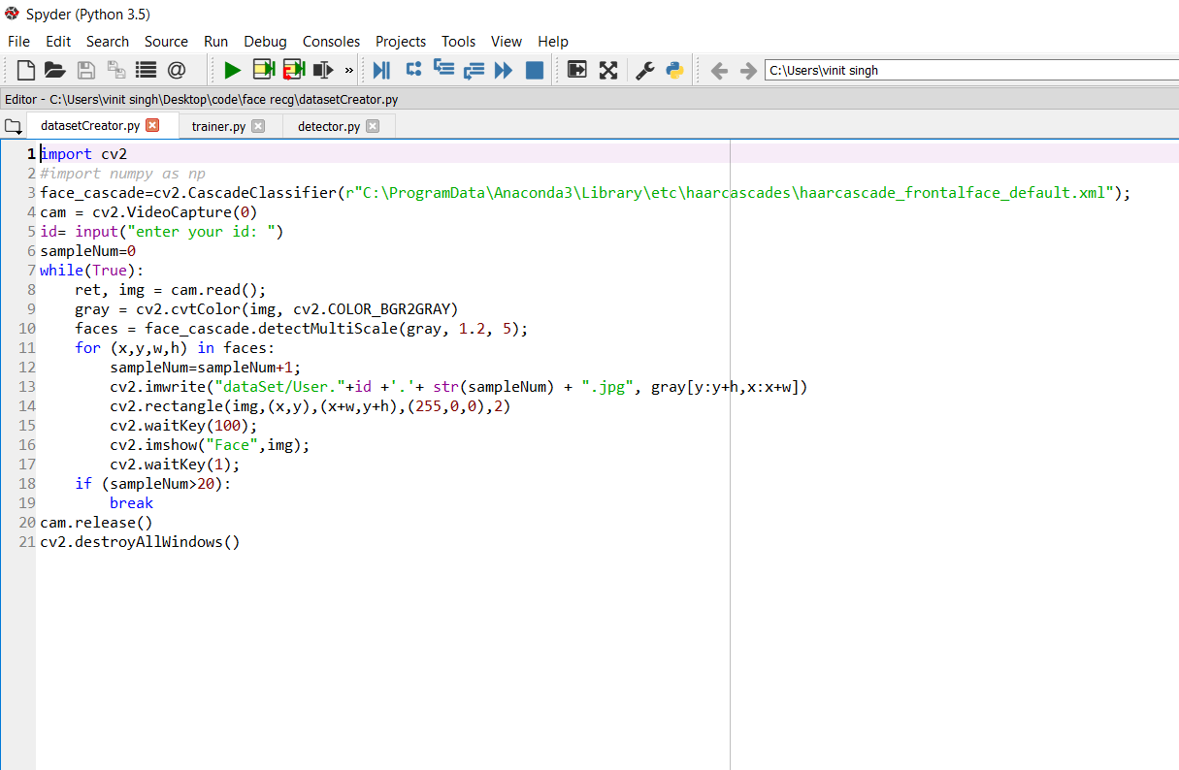

Slide 25
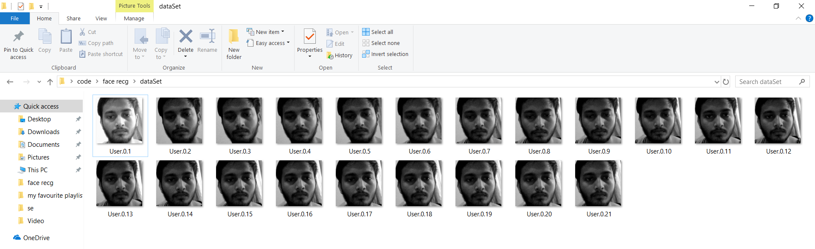
o/p of dataset creator

Slide 26
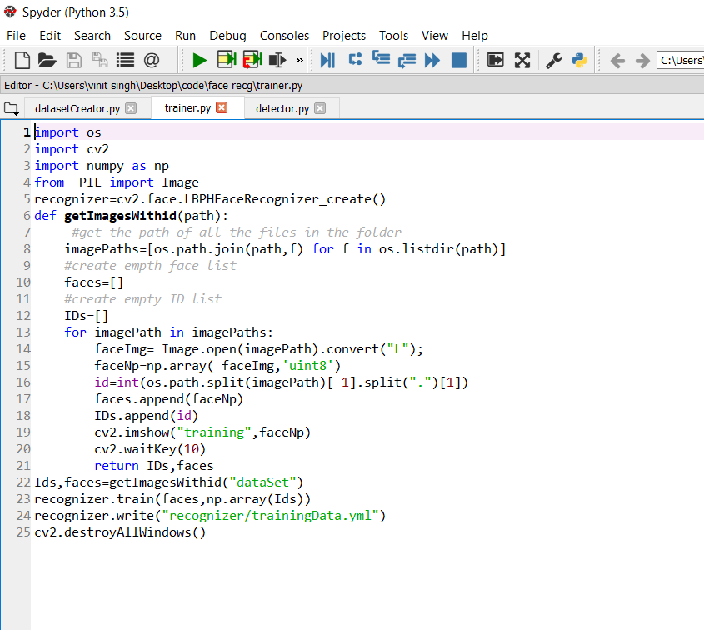
To perform face recognition we need to train a face recognizer, using a pre labeled dataset.we already create a dataset creator with ids
Now train the data save the training data in trainer.

Slide 27
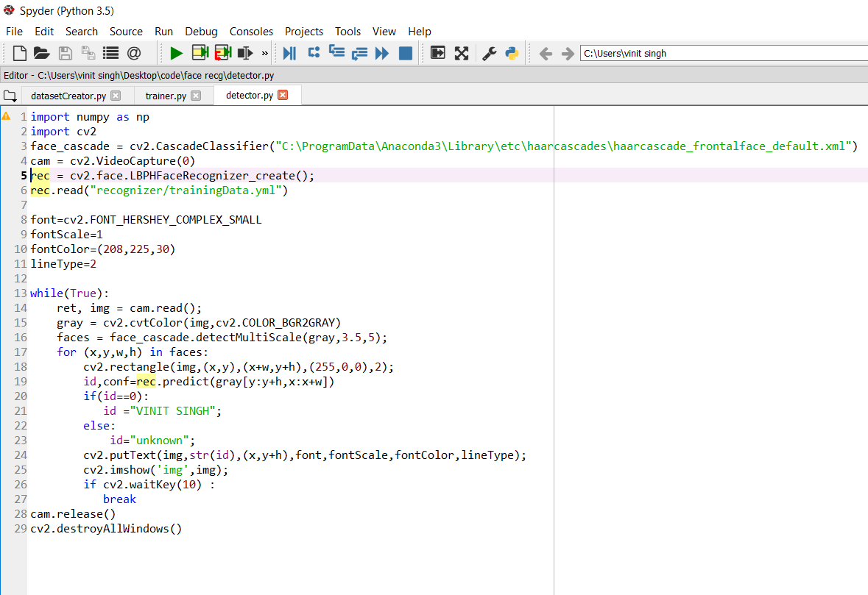
DETECTOR
next we create a recognizer object using opencv library and load the training data (before that just save your script in the same location where your “trainner” folder is located)

Slide 28
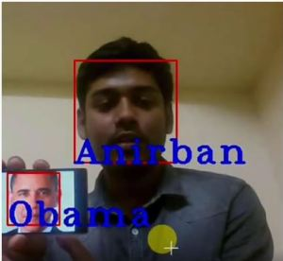
o/p of detector

Slide 29


